Slide 1
Information System Design and Software Engineering Lab Presentation -03
Team: JERM
Presenter: Muhammad Muntasir Mamoor
ID: 14-01-04-072

Slide 2
Data Flow and Use Case Diagram

Slide 3
Activities of Our Project
Booking Order
Car Order
Pay for Booking
Provide Car
Garage
Order Parts/ New Car
Pay for Parts/ New Car
Pay for Employee

Slide 4
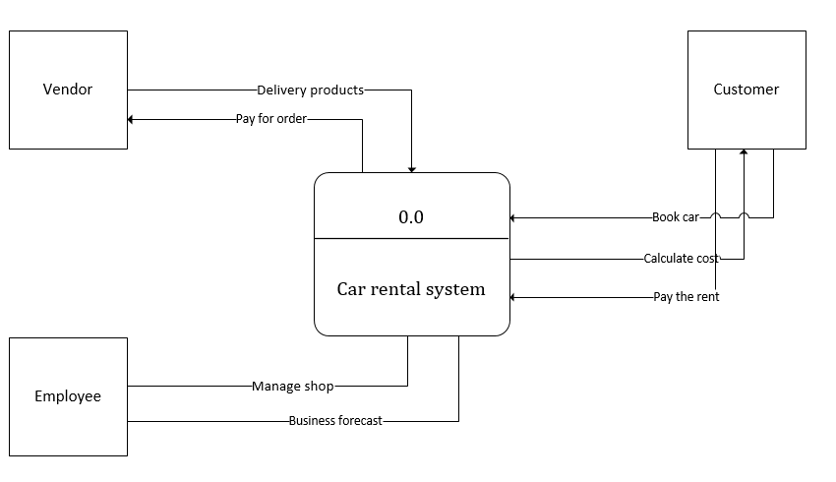
Context Level Diagram

Slide 5
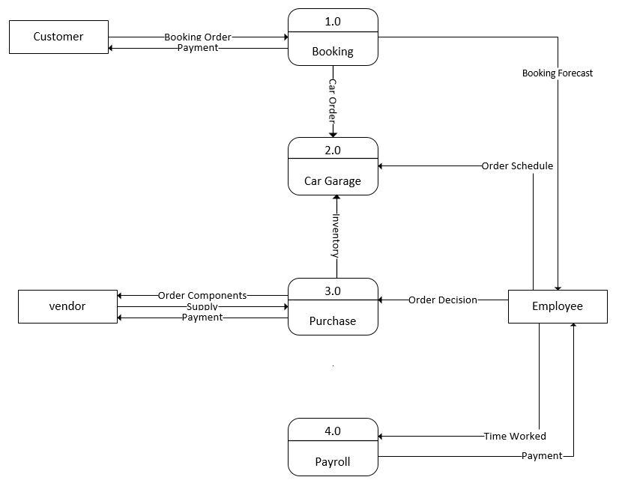
Level 0 Diagram

Slide 6
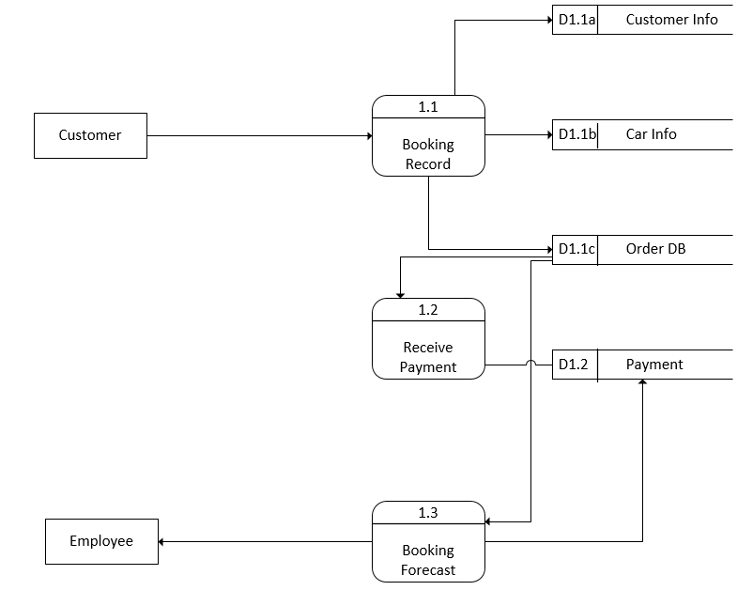
Level 1 Diagram

Slide 7
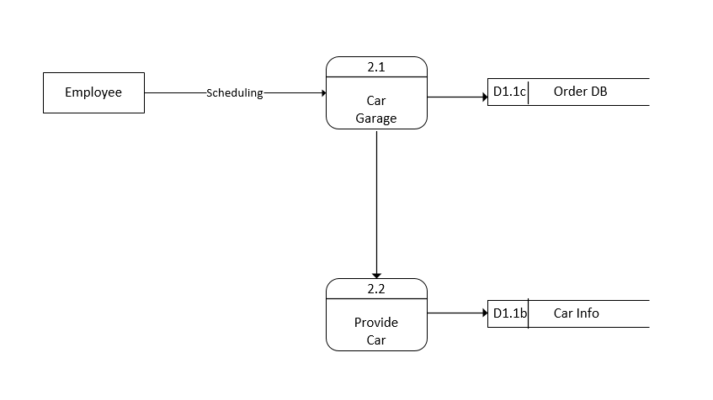
Level 1 Diagram

Slide 8
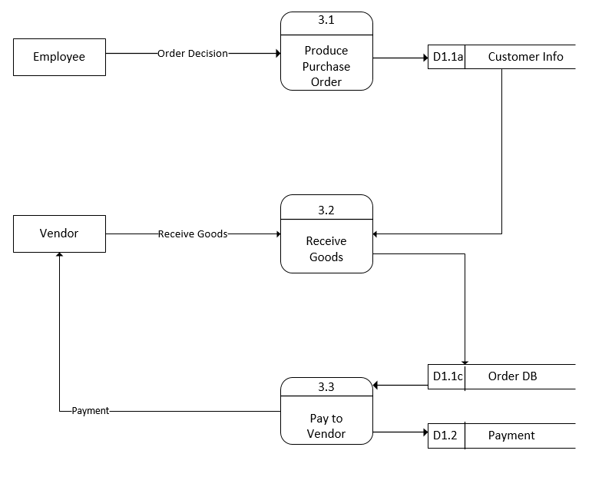
Level 1 Diagram

Slide 9
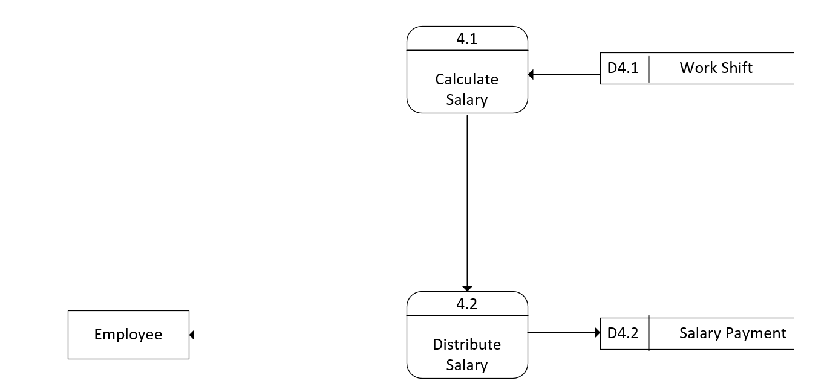
Level 1 Diagram

Slide 10
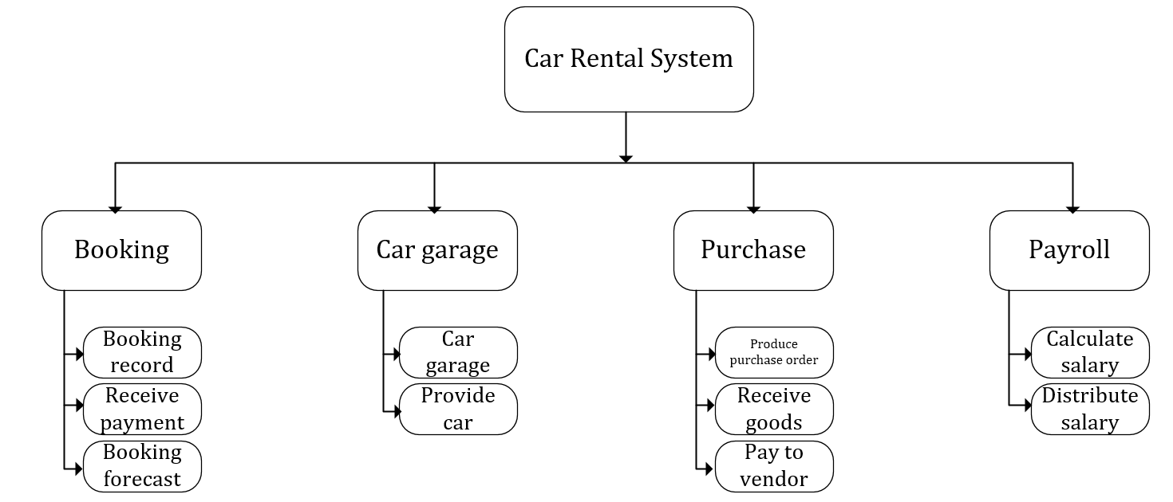
Process Decomposition

Slide 11
Actor
Customer
System
Employee

Slide 12
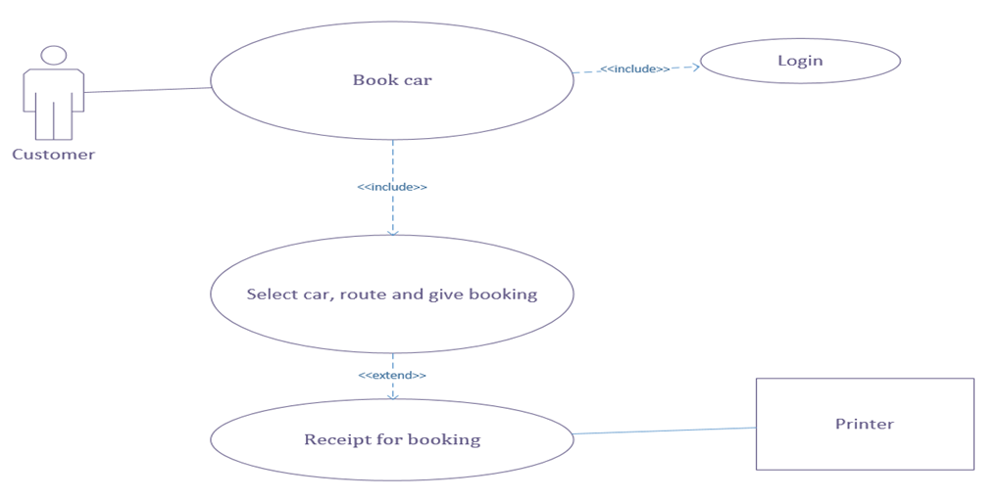
Use Case Diagram

Slide 13
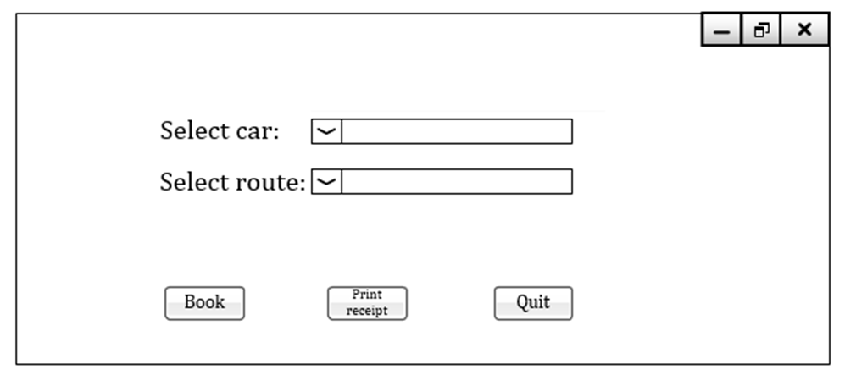
GUI for Use Case Diagram

Slide 14
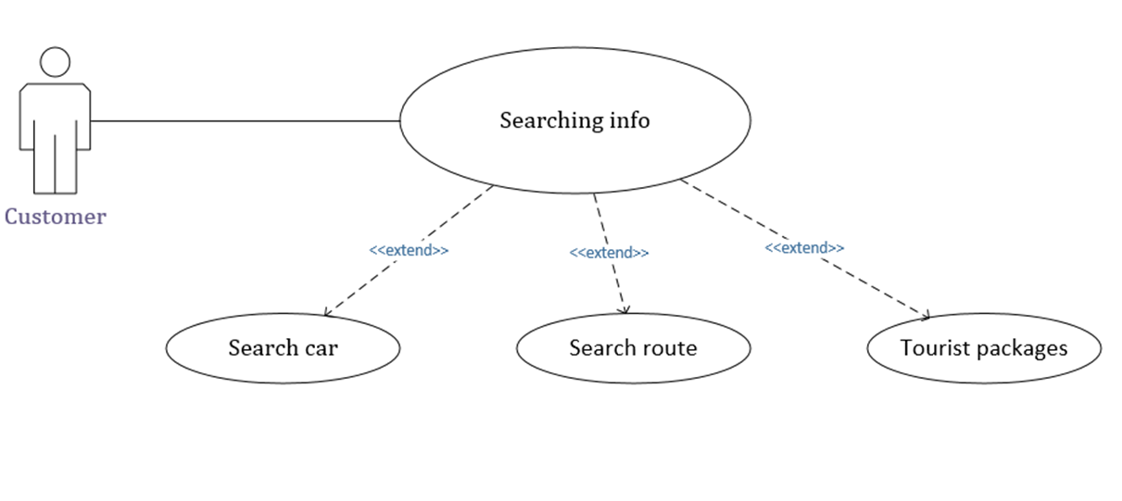
Use Case Diagram

Slide 15
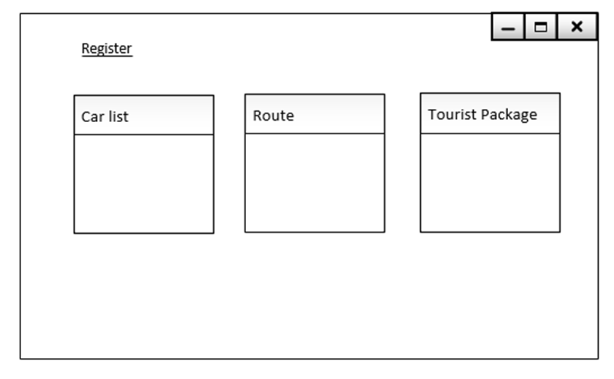
GUI for Use Case Diagram

Slide 16


